Slide 1
Customer Insights and Purchasing Behavior A Data-Driven Approach to Understanding Customer Patterns
Supervised by: Dr. Soha Nagy

Slide 2
Agenda
Introduction to the Dataset and Purpose
Key Objective
Data Overview and Key Metrics Overview
Data Cleaning
Business Questions
Customer Behavior Analysis
Insights from Website Engagement
Product Category Breakdown
Complaint and Response Analysis
Sales Trends Over Time
Actionable Recommendations
Q&A

Slide 3
Overview about data
Data Source Verification:
The data is sourced from a comprehensive marketing dataset available on Kaggle.
Purpose:
To analyze customer insights and purchasing behavior to drive informed business decisions. (e.g., “How can we improve customer engagement and maximize revenue?”).

Slide 4
Overview about data
Fields in the Data:
---------------------
Age: Age of the customer.
Customer_ID: Unique identifier for each customer
Marital Status: Marital status of the customer (e.g., single, married).
Education: Education level of the customer (e.g., graduation, master’s, PhD).
Income: Annual income of the customer.
MntTotal: Total amount of money spent by the customer.
Web Visits: Number of times the customer visited the website.
Web Purchases: Number of purchases made through the website.
Catalog Purchases: Number of purchases made through catalogs.
Store Purchases: Number of purchases made in physical stores.
Complaints: complaints filed by the customer(e.g., Yes, No).
Accepted Campaigns: Number of promotional campaigns accepted by the customer.

Slide 5
Key Objectives
What are we trying to achieve with this analysis?
What are the business goals this analysis is trying to achieve?
How can we use customer behavior data to improve engagement and revenue?

Slide 6
Key Metrics
115.7M
2.3K
1.3M
Total Income
Total Number of Customers
Total Sales
Total income for all customers who made Purchases.
Total number of unique customers who made a purchase
The total revenue from sales

Slide 7
Key Metrics
11.9K
13K
9.1K
No. Web Visits
Store Purchases
Web Purchases
Total number of purchases made in physical stores
It is a measure of the website's popularity and how many people are visiting it.
Total number of purchases made through the market’s website

Slide 8
Key Metrics
5.2K
6K
Deals Purchases
Catalog Purchases
The total number of purchases made through special deals or promotions
The total number of purchases made from a catalog

Slide 9
Business Questions
How do customer influence purchasing behavior?
What are the top-performing product categories and sales channels?
How effective are our marketing campaigns in driving sales?
How do customer complaints impact overall spending and satisfaction?

Slide 10
Customer Behavior Analysis
01
02
03
04
How do different age groups contribute to overall sales?
How does the level of education impact purchasing behavior?
Do married or single customers tend to spend more?
What income brackets generate the highest sales?

Slide 11
Insights from Website Engagement
01
02
03
04
Is there a direct relationship between website visits and purchases?
Do customers who visit the website more frequently also purchase more?
Which months or periods had the highest web engagement?
How do website visits differ based on customer Requests?

Slide 12
Product Category Breakdown
01
02
03
04
What are the top-selling product categories?
Are there any categories that consistently underperform?
Which product categories contribute the most to revenue growth?
How does customer age or income influence category preferences?

Slide 13
Complaint and Response Analysis
01
02
03
04
Do customers who file complaints spend less than those who don't?
How many customers who file complaints continue to make purchases afterward?
What is the impact of complaint resolution on customer loyalty?
Is there a specific product category that generates more complaints?

Slide 14
Sales Trends Over Time
01
02
03
04
Which months show the highest sales growth?
Are there any noticeable seasonal sales patterns?
How do sales trends correspond with marketing campaigns or external events?
Is there a consistent upward or downward trend in sales?

Slide 15
01
Customer Behavior Analysis
In this section, you want to focus on how customer attributes (such as age, marital status, and income) affect their purchasing behavior

Slide 16
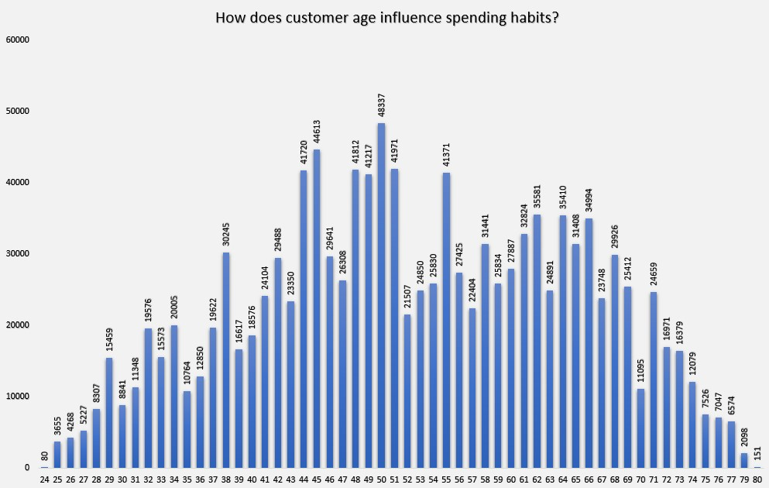
How does customer age influence spending habits?
This chart examines how income correlates with customer spending, providing a breakdown of income brackets and how much they contribute to total sales.

Slide 17
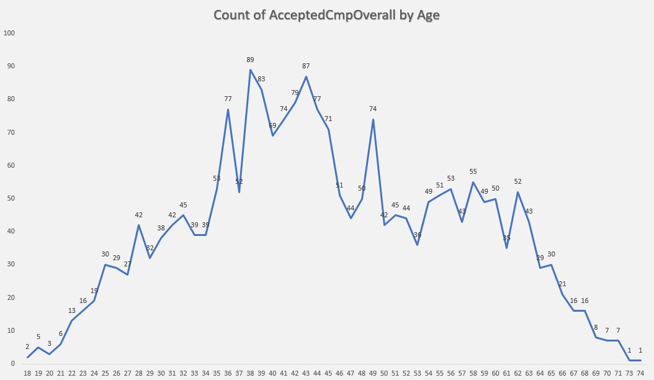
Age Distribution and Spending Behavior
This line chart illustrates how different age groups respond to marketing campaigns, measured by the number of accepted campaigns per age bracket.

Slide 18
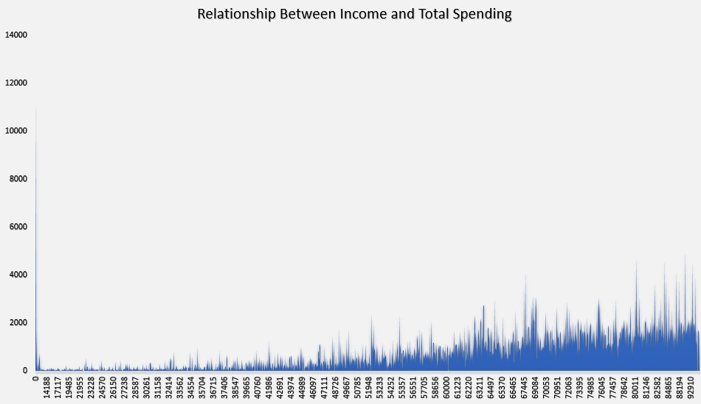
Income vs. Total Spending
This is Area Chart examines how income correlates with customer spending, providing a breakdown of income brackets and how much they contribute to total sales.

Slide 19
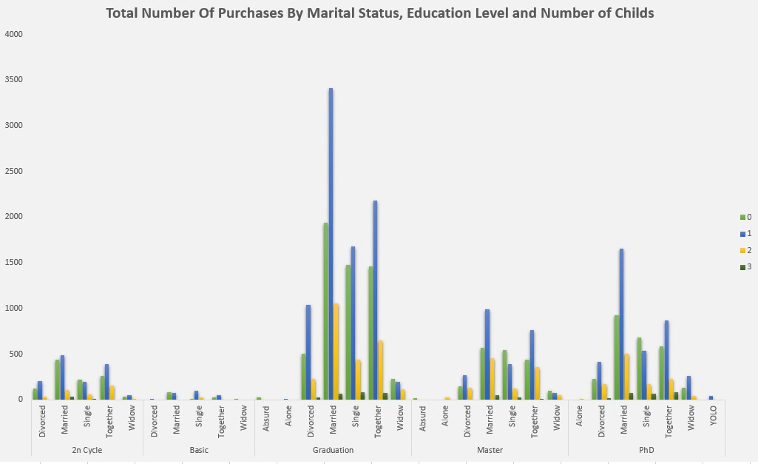
Marital Status, Educational Level, Number Of Childs and Number of Purchases
This chart visualizes how various personal factors such as marital status, education, and number of children influence the number of purchases a customer makes.

Slide 20
02
Insights from Website Engagement
This section focuses on how customer interactions with the website affect purchasing behavior.

Slide 21
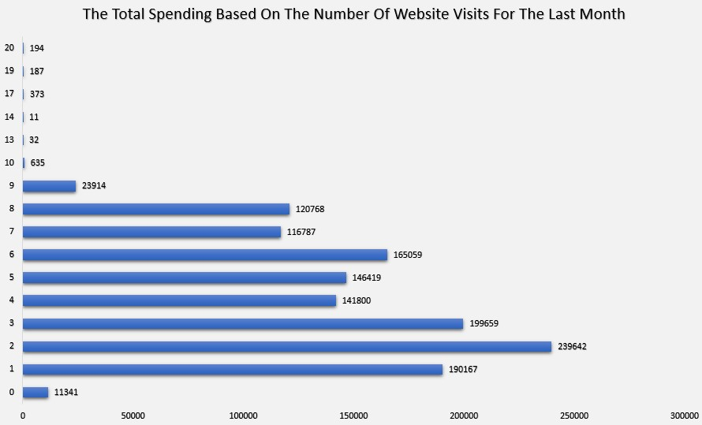
The Total Spending Based On The Number Of Website Visits For The Last Month
This horizontal bar chart shows the relationship between website visits and the total number of purchases.

Slide 22
03
Product Category Breakdown
This section dives into the performance of different product categories.

Slide 23
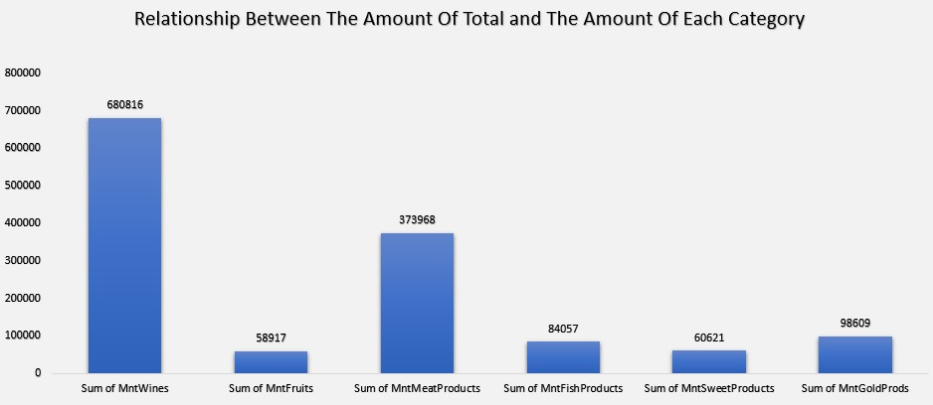
Relationship Between The Amount Of Total and The Amount Of Each Category
This bar chart illustrates the total amount spent across different product categories (Wine, Fruits, Meat, Fish, Sweets, Gold Products).

Slide 24
04
Complaint and Response Analysis
the focus is on how complaints affect customer satisfaction and spending.

Slide 25
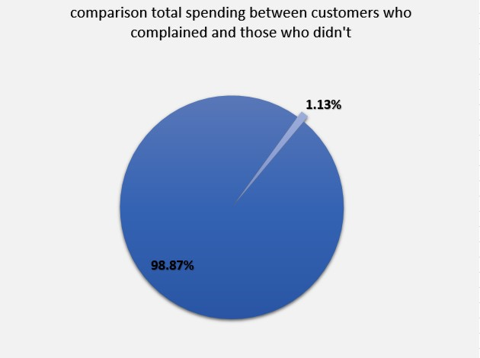
Comparison of Total Spending Between Customers complaints
This Pie chart compares the total spending of customers who filed complaints versus those who didn’t.
1.13%
Customers Who Complained
98.87%
Customers Who Not Complained

Slide 26
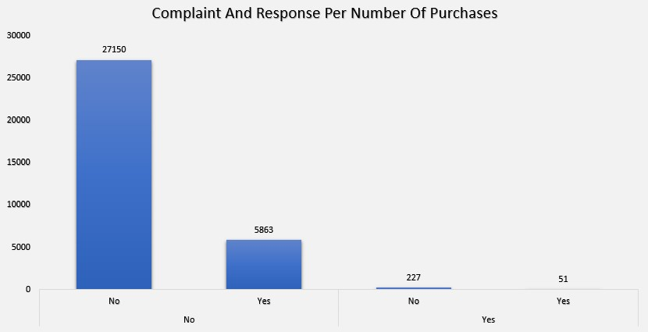
Complaint And Response Per Number Of Purchases
The bar chart breaks down the number of complaints and Responses based on the number of purchases.

Slide 27
05
Sales Trends Over Time

Slide 28
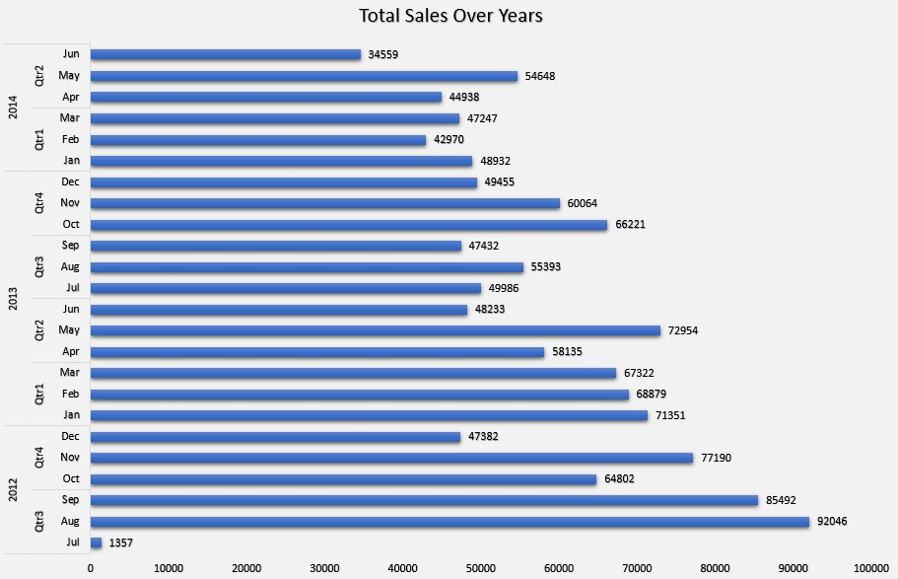
Age Distribution and Spending Behavior
The horizontal bar chart breaks down total sales by year and month, showing trends over time.

Slide 29
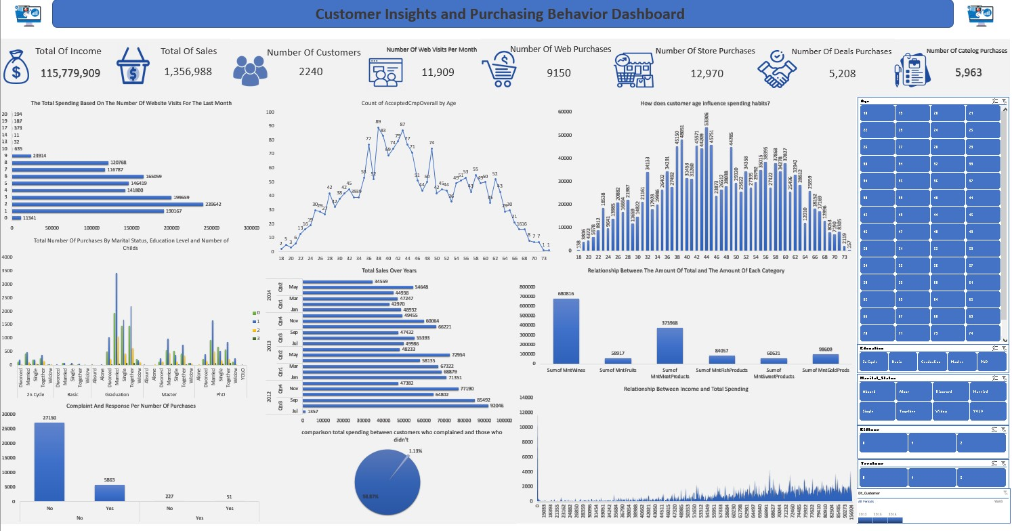
Dashboard

Slide 30
Actionable Recommendations
Improving Customer Engagement and Revenue

Slide 31
Insight VS. Action
Insight
Action
Enhance Targeted Campaigns by Age Group
Customers aged 30-40 show the highest engagement with marketing campaigns.
Focus on creating personalized campaigns for each age group, leveraging their preferences and spending behavior

Slide 32
Insight VS. Action
Insight
Action
Increase Online Sales by Optimizing Website Experience
Website visits result in significant purchases, but web purchases are still lower than store purchases.
Improve the user experience on the website by enhancing ease of navigation and streamlining the checkout process.

Slide 33
Insight VS. Action
Insight
Action
Focus on High-Performing Product Categories
Certain categories, such as Wines drive the most revenue.
Prioritize stocking and marketing top-selling categories and Run specific campaigns and cross-promotions based on these products to maximize sales and customer interest.

Slide 34
Actionable Recommendations
Increasing Customer Satisfaction and Long-Term Growth

Slide 35
Insight VS. Action
Insight
Action
Address Customer Complaints Proactively
Customers who file complaints tend to spend less and have lower satisfaction levels.
Implement faster response mechanisms for complaints, Offer incentives like discounts or free products to customers who file complaints to turn negative experiences into positive outcomes.

Slide 36
Insight VS. Action
Insight
Action
Drive Engagement Through Website Visits
High website traffic can lead to more sales when properly harnessed.
Use retargeting ads and follow-up emails for users who visit but do not make purchases,
Implement loyalty programs that encourage repeat visits and purchasing behavior.

Slide 37
Insight VS. Action
Insight
Action
Leverage Seasonal Sales Trends
Sales show certain seasonal or time-based trends.
Align marketing efforts with these peaks to maximize sales, run promotional campaigns during peak months or optimize inventory and staffing around these times.

Slide 38
Our primary target
is to enhance customer engagement and increase revenue by leveraging insights into customer behavior and purchasing patterns.

Slide 39
Thanks!
Do you have any questions?
an1977304@gmail.com
Made By: Ahmed Nour Yahya

